Slide 1
CONFIGURING Local storage

Slide 2
Overview
Planning server storage
Understanding Windows disk settings
Selecting a partition style
Understanding volume types
Understanding file systems
Working with disks
Adding a new physical disk
Creating and mounting virtual hard disks (VHDs)
Creating a storage pool
Creating virtual disks
Creating a simple volume
Creating a striped, spanned, mirrored, or RAID-5 volume

Slide 3
Planning server storage

Slide 4
Planning server storage
A Windows server can conceivably perform its tasks using the same type of storage as a workstation; that is, one or more standard hard disks connected to a standard drive interface such as Serial ATA (SATA).
However, the I/O burdens of a server are different from those of a workstation; a standard storage subsystem can easily be overwhelmed by file requests from dozens or hundreds of users.
In addition, standard hard disks offer no fault tolerance and are limited in their scalability.

Slide 5
Planning server storage (Contd.,)
A variety of storage technologies are better suited for server use.
The process of designing a storage solution for a server depends on several factors, including the following:
The amount of storage the server needs
The number of users who will be accessing the server at the same time
The sensitivity of the data to be stored on the server
The importance of the data to the organization
The following sections examine these factors and the technologies you can choose when creating a plan for your network storage solutions.

Slide 6
How many servers do I need?
The number of servers you need can depend on how often your users work with the same resources and how much fault tolerance and high availability you want to build into the system.
For example, if each department in your organization typically works with its own applications and documents and rarely needs access to those of other departments, deploying individual servers to each department might be preferable.
If everyone in your organization works with the same set of resources, centralized servers might be a better choice.

Slide 7
Estimating storage requirements
The amount of storage space you need in a server depends on a variety of factors, not just the initial requirements of your applications and users.
In the case of an application server, start by allocating the amount of space needed for the application files themselves plus any other space the application needs, as recommended by the developer.
If users will be storing documents on the server, then allocate a specific amount of space for each user the server will support.
Then factor in the potential growth of your organization and your network, both in terms of additional users and additional space required by each user and of data files and updates to the application itself.

Slide 8
Selecting Storage Technology-Storage Spaces
Storage virtualization technology in Windows Server 2012 R2 and Windows Server 2012 that enables you to group industry-standard disks into storage pools and then create virtual disks called storage spaces from free space in the pools.
In Windows Server 2012 R2, you can create tiered storage spaces with a mixture of solid state drives (SSD) (fast tier) and hard disk drives (standard tier).
Frequently accessed (hot) data in a tiered storage space gets moved to the SSDs in the fast tier, while infrequently accessed (cold) data is moved to the high-capacity hard disks in the standard tier.
This enables you to balance capacity and performance.
Notes:
https://technet.microsoft.com/en-us/library/dn610883(v=ws.11).aspx

Slide 9
Selecting Storage Technology-Server Message Block 3.0
Network file sharing protocol that allows applications on a computer to read and write to files and to request services from server programs in a computer network.
SMB Direct is a feature in SMB 3.0 that delivers scalable, fast, and efficient storage access.
You can also benefit from fast data transfers and network fault tolerance by using the SMB Multichannel feature.
SMB Multichannel and SMB Direct improve network communications between your Hyper-V server cluster and your file server cluster.
It also improves internode communications within your file server cluster.
Windows Server 2012 R2 uses the SMB 3.0 protocol.
SMB Direct improves your cloud deployment storage by using a network adapter that has Remote Direct Memory Access (RDMA) capability.
It can function at full speed with very low latency, while using very little CPU.
SMB Multichannel delivers network bandwidth aggregation and network fault tolerance if multiple paths are available between the SMB client and the SMB server.
Notes:
SMB Multichannel is a much easier solution which offers great performance. SMB Multichannel will automatically make use of different network adapters which are configured with different IP subnets.
SMB Direct is an extension of the Server Message Block technology by Microsoft used for file operations. The Direct part implies the use of various high speed Remote Data Memory Access (RDMA) methods to transfer large amounts of data with little CPU intervention.

Slide 10
Selecting Storage Technology- Data Deduplication..
Find and remove duplication within data without compromising its fidelity or integrity.
The goal is to store more data in less space by segmenting files into small variable-sized chunks (32–128 KB), identifying duplicate chunks, and maintaining a single copy of each chunk.
Redundant copies of the chunk are replaced by a reference to the single copy.
The chunks are compressed and then organized into special container files in the System Volume Information folder.
Data Deduplication is ideal for numerous workloads including:
General file shares: Group content publication and sharing, user home folders, and Folder Redirection and offline files
Software deployment shares: Software binaries, images, and updates
Virtual hard disk (VHD) libraries: VHD file storage for provisioning to hypervisors
Virtual Desktop Infrastructure (VDI) deployments that use Hyper-V (Windows Server 2012 R2 only)
Notes:
Chunk File is a small and handy application designed to help you split large files into pieces of a set size, so you can easily transfer them

Slide 11
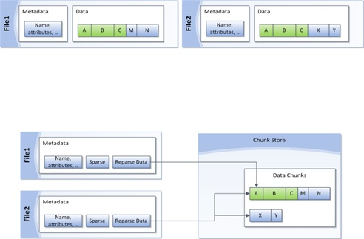
Selecting Storage Technology- Data Deduplication (Contd.)
As shown in Figure , after deduplication, files are no longer stored as independent streams of data, and they are replaced with stubs that point to data blocks that are stored within a common chunk store. Because these files share blocks, those blocks are only stored once, which reduces the disk space needed to store all files.

Slide 12
Practical applications of Data Deduplication
Capacity optimization.
Scale and performance
Reliability and data integrity.
Bandwidth efficiency with Branch Cache.
Optimization management with familiar tools.
Notes:
Capacity optimization. Data deduplication stores more data in less physical space. It achieves greater storage efficiency than was possible by using features such as Single Instance Storage (SIS) or NTFS compression. Data deduplication uses subfile variable-size chunking and compression, which deliver optimization ratios of 2:1 for general file servers and up to 20:1 for virtualization data.
Scale and performance. Data deduplication is highly scalable, resource efficient, and nonintrusive. It can process up to 50 MB per second in Windows Server 2012 R2, and about 20 MB of data per second in Windows Server 2012. It can run on multiple volumes simultaneously without affecting other workloads on the server. Low impact on the server workloads is maintained by throttling the CPU and memory resources that are consumed. If the server gets very busy, deduplication can stop completely. In addition, administrators have the flexibility to run data deduplication jobs at any time, set schedules for when data deduplication should run, and establish file selection policies.
Reliability and data integrity. When data deduplication is applied, the integrity of the data is maintained. Data Deduplication uses checksum, consistency, and identity validation to ensure data integrity. For all metadata and the most frequently referenced data, data deduplication maintains redundancy to ensure that the data is recoverable in the event of data corruption.
Bandwidth efficiency with BranchCache. Through integration with BranchCache, the same optimization techniques are applied to data transferred over the WAN to a branch office. The result is faster file download times and reduced bandwidth consumption.
Optimization management with familiar tools. Data deduplication has optimization functionality built into Server Manager and Windows PowerShell. Default settings can provide savings immediately, or administrators can fine-tune the settings to see more gains. One can easily use Windows PowerShell cmdlets to start an optimization job or schedule one to run in the future. Installing the Data Deduplication feature and enabling deduplication on selected volumes can also be accomplished by using an Unattend.xml file that calls a Windows PowerShell script and can be used with Sysprep to deploy deduplication when a system first boots.

Slide 13
Selecting Storage Technology- Cluster Shared Volumes (CSV)
Multiple nodes in a failover cluster can simultaneously have Read and Write access to the same volume.
CSV simplify the configuration and management of virtual machines that are running on a cluster.
With CSV, multiple virtual machines that run on a cluster can use the same physical disk, while still being able to fail over independently of one another.
Cluster Shared Volumes provide multiple benefits, including easier storage management and greater resiliency to failures.
With CSV you can:
Easily integrate with Storage Spaces.
Scale out access to your data by creating virtualized cluster storage that uses groups of inexpensive disks in JBODs. CSV also supports tiered storage spaces and write-back caching.
Use with SMB Multichannel and SMB Direct. This allows CSV traffic to stream across multiple networks in the cluster and leverage network adapters that support RDMA.
Notes:
Cluster Shared Volumes (CSV) enable multiple nodes in a failover cluster to simultaneously have read-write access to the same LUN (disk) that is provisioned as an NTFS volume. ... CSV provide a general-purpose, clustered file system, which is layered above NTFS (or ReFS in Windows Server 2012 R2).
JBOD (just a bunch of disks,or just a bunch of drives)
RDMA- Remote Direct Memory Access

Slide 14
Selecting Storage Technology- Scale-Out File Server
Scale-Out File Server is a feature that is designed to provide scale-out file shares that are continuously available for file-based server application storage.
Scale-out file shares provides the ability to share the same folder from multiple nodes of the same cluster.
You can deploy and configure a clustered file server by using either of the following methods:
Scale-Out File Server for application data
File Server for general use
Notes:
You can deploy and configure a clustered file server by using either of the following methods:
Scale-Out File Server for application data This clustered file server feature was introduced in Windows Server 2012, and it lets you store server application data, such as Hyper-V virtual machine files, on file shares, and obtain a similar level of reliability, availability, manageability, and high performance that you would expect from a storage area network. All file shares are simultaneously online on all nodes. File shares associated with this type of clustered file server are called scale-out file shares. This is sometimes referred to as active-active. This is the recommended file server type when deploying either Hyper-V over Server Message Block (SMB) or Microsoft SQL Server over SMB.
File Server for general use This is the continuation of the clustered file server that has been supported in Windows Server since the introduction of Failover Clustering. This type of clustered file server, and therefore all the shares associated with the clustered file server, is online on one node at a time. This is sometimes referred to as active-passive or dual-active. File shares associated with this type of clustered file server are called clustered file shares. This is the recommended file server type when deploying information worker scenarios.

Slide 15
Key benefits provided by Scale-Out File Server
Active-Active file shares
Increased bandwidth
CHKDSK with zero downtime
Clustered Shared Volume cache
Simpler management
Automatic rebalancing of Scale-Out File Server clients
Notes:
Active-Active file shares All cluster nodes can accept and serve SMB client requests. By making the file share content accessible through all cluster nodes simultaneously, SMB 3.0 clusters and clients cooperate to provide transparent failover to alternative cluster nodes during planned maintenance and unplanned failures with service interruption.
Increased bandwidth The maximum share bandwidth is the total bandwidth of all file server cluster nodes. Unlike previous versions of Windows Server, the total bandwidth is no longer constrained to the bandwidth of a single cluster node; but rather, the capability of the backing storage system defines the constraints. You can increase the total bandwidth by adding nodes.
CHKDSK with zero downtime CHKDSK in Windows Server 2012 is significantly enhanced to dramatically shorten the time a file system is offline for repair. Clustered shared volumes (CSVs) take this one step further by eliminating the offline phase. A CSV File System (CSVFS) can use CHKDSK without impacting applications with open handles on the file system.
Clustered Shared Volume cache CSVs in Windows Server 2012 introduces support for a Read cache, which can significantly improve performance in certain scenarios, such as in Virtual Desktop Infrastructure (VDI).
Simpler management With Scale-Out File Server, you create the scale-out file servers, and then add the necessary CSVs and file shares. It is no longer necessary to create multiple clustered file servers, each with separate cluster disks, and then develop placement policies to ensure activity on each cluster node.
Automatic rebalancing of Scale-Out File Server clients In Windows Server 2012 R2, automatic rebalancing improves scalability and manageability for scale-out file servers. SMB client connections are tracked per file share (instead of per server), and clients are then redirected to the cluster node with the best access to the volume used by the file share. This improves efficiency by reducing redirection traffic between file server nodes. Clients are redirected following an initial connection and when cluster storage is reconfigured.

Slide 16
Using Storage Spaces
Windows Server 2012 R2 includes a disk virtualization technology called Storage Spaces, which enables a server to concatenate storage space from individual physical disks and allocate that space to create virtual disks of any size supported by the hardware.
Storage Spaces uses unallocated disk space on server drives to create storage pools.
A storage pool can span multiple drives invisibly, providing an accumulated storage resource that administrators can expand or reduce as needed by adding disks to or removing them from the pool.

Slide 17
Using Storage Spaces (Contd.,)
After creating a virtual disk, you can create volumes on it just as you would on a physical disk.
Server Manager provides the tools you need to create and manage storage pools and virtual disks and provides you with the ability to create volumes and file system shares, with some limitations.

Slide 18
Understanding Windows disk settings

Slide 19
Understanding Windows disk settings
When you install Windows Server 2012 R2 on a computer, the setup program automatically performs all the preparation tasks for the primary hard disk in the system.
However, when you install additional hard disk drives on a server, or when you want to use settings that differ from the system defaults, you must perform the following tasks manually.

Slide 20
Understanding Windows disk settings (cont.,)
The following tasks perform manually to configure windows disk setting:
Select a partitioning style
Select a disk type
Divide the disk into partitions or volumes
Format the partitions or volumes with a file system

Slide 21
Select a partitioning style
Windows Server 2012 R2 supports two hard disk partition styles:
the master boot record (MBR) partition style
the GUID (globally unique identifier) partition table (GPT) partition style.
You must choose one of these partition styles for a drive; you cannot use both.

Slide 22
Select a disk type
Windows Server 2012 R2 supports two disk types:
the basic disk type
the dynamic disk type.
You cannot use both types on the same disk drive, but you can mix disk types in the same computer.

Slide 23
Basic Disk Storage
A basic disk uses primary partitions, extended partitions, and logical drives to organize data.
A formatted partition is also called a volume (the terms volume and partition are often used interchangeably).
In this version of Windows, basic disks can have either four primary partitions or three primary and one extended partition.
The extended partition can contain an unlimited number of logical drives.
The partitions on a basic disk cannot share or split data with other partitions.
Each partition on a basic disk is a separate entity on the disk.

Slide 24
Dynamic Disk Storage
Dynamic disks provide features that basic disks do not, such as the ability to create volumes that span multiple disks (spanned and striped volumes) and the ability to create fault-tolerant volumes (mirrored and RAID-5 volumes)
It contain an unlimited number of dynamic volumes that function like the primary partitions used on basic disks.
The main difference between basic disks and dynamic disks is that dynamic disks are able to split or share data among two or more dynamic hard disks on a computer.
For example, a single dynamic volume may actually be made up of storage space on two separate hard disks. Also, dynamic disks can duplicate data among two or more hard disks to guard against the chance of a single disk failing.

Slide 25
Divide the disk into partitions or volumes
Although many professionals use the terms partition and volume interchangeably, it is correct to refer to partitions on basic disks and volumes on dynamic disks

Slide 26
Format the partitions or volumes with a file system
Windows Server 2012 R2 supports the NTFS file system, the FAT file system (including the FAT16, FAT32, and exFAT variants), and the new ReFS file system
Notes:
ReFS – Resilient File System

Slide 27
Selecting a partition style
The term partition style refers to the method that Windows operating systems use to organize partitions on the disk. Servers running Windows Server 2012 R2 computers can use either of the following two hard disk partition styles:
MBR The MBR partition style has been around since before Windows and is still a common partition style for x86-based and x64-based computers.

Slide 28
Selecting a partition style (Contd.,)
GPT It has existed since the late 1990s, but no x86 version of Windows prior to Windows Server 2008 and Windows Vista supports it. Today, most operating systems support GPT, including Windows Server 2012 R2.
When you use Server Manager to initialize a disk in Windows Server 2012 R2, it uses the GPT partition style, whether it is a physical or a virtual disk. There are no controls in Server Manager supporting MBR, although it displays the partition style in the Disks tile.

Slide 29
Understanding disk types
Most personal computers use basic disks because they are the easiest to manage.
Advanced volume types require the use of dynamic disks.
A basic disk using the MBR partition style organizes data by using primary partitions, extended partitions, and logical drives.
A primary partition appears to the operating system as though it is a physically separate disk and can host an operating system, in which case it is known as the active partition.

Slide 30
Understanding disk types (Contd.,)
When you work with basic MBR disks in Windows Server 2012 R2 using the Disk Management snap-in, you can create three volumes that take the form of primary partitions.
When you create the fourth volume, the system creates an extended partition, with a logical drive on it, of the size you specified.
If there is free space left on the disk, the system allocates it to the extended partition, as shown in Figure, where you can use it to create additional logical drives.

Slide 31

Understanding disk types (Contd.,)
Fig: Primary and extended partitions on a basic disk using MBR

Slide 32
Understanding disk types (Contd.,)
When you select the GPT partition style, the disk still appears as a basic disk, but you can create up to 128 volumes, each of which appears as a primary partition, as shown in Figure.
There are no extended partitions or logical drives on GPT disks.
The alternative to using a basic disk is to convert it to a dynamic disk. The process of converting a basic disk to a dynamic disk creates a single partition that occupies the entire disk.

Slide 33

Understanding disk types (Contd.,)
Fig: Primary partitions on a basic disk using GPT

Slide 34
Understanding volume types
A dynamic disk can contain an unlimited number of volumes that function much like primary partitions on a basic disk, but you cannot mark an existing dynamic disk as active.
When you create a volume on a dynamic disk by using the Disk Management snap-in in Windows Server 2012 R2, you choose from the following five volume types.

Slide 35
Understanding volume types (Contd.,)
Simple volume Consists of space from a single disk.
After you have created a simple volume, you can extend it to multiple disks to create a spanned or striped volume, as long as it is not a system volume or boot volume.
You can also extend a simple volume into any adjacent unallocated space on the same disk or, with some limitations, shrink the volume by deallocating any unused space in the volume.

Slide 36
Understanding volume types (Contd.,)
Spanned volume Consists of space from 2 to 32 physical disks, all of which must be dynamic disks.
A spanned volume is essentially a method for combining the space from multiple dynamic disks into a single large volume.
Windows Server 2012 R2 writes to the spanned volume by filling all the space on the first disk and then filling each of the additional disks in turn.
You can extend a spanned volume at any time by adding disk space.
Creating a spanned volume does not increase the disk’s read/write performance or provide fault tolerance

Slide 37
Understanding volume types (Contd.,)
RAID-0 Striped volume Consists of space from 2 to 32 physical disks, all of which must be dynamic disks.
The difference between a striped volume and a spanned volume is that in a striped volume, the system writes data one stripe at a time to each successive disk in the volume.
Striping provides improved performance because each disk drive in the array has time to seek the location of its next stripe while the other drives are writing.
Striped volumes do not provide fault tolerance, however, and you cannot extend them after creation.
If a single physical disk in the striped volume fails, all the data in the entire volume is lost.

Slide 38
Understanding volume types (Contd.,)
Raid-1 Mirrored volume Consists of an identical amount of space on two physical disks, both of which must be dynamic disks.
The system performs all read and write operations on both disks simultaneously so they contain duplicate copies of all data stored on the volume.
If one disk fails, the other continues to provide access to the volume until the failed disk is repaired or replaced.

Slide 39
Understanding volume types (Contd.,)
RAID-5 volume Consists of space on three or more physical disks, all of which must be dynamic.
The system stripes data and parity information across all the disks so that if one physical disk fails, the missing data can be re-created by using the parity information on the other disks.
RAID-5 volumes provide improved read performance because of the disk striping, but write performance suffers due to the need for parity calculations.

Slide 40
Understanding file systems
To organize and store data or programs on a hard drive, you must install a file system.
A file system is the underlying disk drive structure that enables you to store information on your computer.
You install file systems by formatting a partition or volume on the hard disk.
In Windows Server 2012 R2, five file system options are available:
NTFS
FAT32
exFAT
FAT (also known as FAT16)
ReFS

Slide 41
Understanding file systems (Contd.,)
NTFS is the preferred file system for a server; the main benefits are improved support for larger hard drives than FAT and better security in the form of encryption and permissions that restrict access by unauthorized users.
Because the FAT file systems lack the security that NTFS provides, any user who gains access to your computer can read any file without restriction.
Additionally, FAT file systems have disk size limitations:
FAT32 cannot handle a partition greater than 32 GB or a file greater than 4 GB.
FAT cannot handle a hard disk greater than 4 GB or a file greater than 2 GB.
Notes:
Because of these limitations, the only viable reason for using FAT16 or FAT32 is the need to dual boot the computer with a non-Windows operating system or a previous version of Windows that does not support NTFS, which is not a likely configuration for a server.

Slide 42
Understanding file systems (Contd.,)
Resilient File System (ReFS) is a new file system first appearing in Windows Server 2012 R2 that offers practically unlimited file and directory sizes and increased resiliency that eliminates the need for error checking tools, such as Chkdsk.exe.
However, ReFS does not include support for NTFS features such as file compression, Encrypted File System (EFS), and disk quotas.
ReFS disks also cannot be read by any operating systems older than Windows Server 2012 and Windows 8.

Slide 43
Working with disks

Slide 44
Working with disks
Windows Server 2012 R2 includes tools that enable you to manage disks graphically or from the command prompt.
All Windows Server 2012 R2 installations include the File and Storage Services role, which causes Server Manager to display a menu when you click the icon in the navigation pane, as shown in Figure.
This menu provides access to home pages that enable administrators to manage volumes, disks, storage pools, shares, and iSCSI devices.
Notes:
Internet Small computer system interface

Slide 45
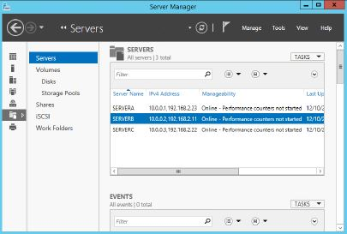
Working with disks (Contd.,)
Fig: Using the File and Storage Services menu in Server Manager

Slide 46
Working with disks (Contd.,)
Server Manager is the only graphical tool that can manage storage pools and create virtual disks.
It can also perform some—but not all—of the standard disk and volume management operations on physical disks.
Disk Management is an MMC snap-in that is the traditional tool for performing disk related tasks.
To access the Disk Management snap-in, open the Computer Management console and select Disk Management.
You can also manage disks and volumes from the command line by using the DiskPart.exe utility.
Notes:
Like the other Server Manager home pages, the File page and the Storage Services page enables you to perform tasks on any servers you have added to the interface.

Slide 47
Adding a new physical disk
When you add a new hard disk to a Windows Server 2012 R2 computer, you must initialize the disk before you can access its storage.
To add a new secondary disk, shut down the computer and install or attach the new physical disk per the manufacturer’s instructions.
A newly added physical disk is listed in Server Manager in the Disks tile, as shown in Figure, with a status of Offline and an unknown partition style.

Slide 48
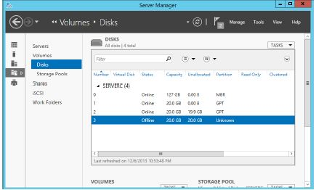
Adding a new physical disk (Contd.,)
Fig: A newly added physical disk in Server Manager

Slide 49
Adding a new physical disk (Contd.,)
To make the disk accessible, you must first bring it online by right-clicking it in the Disks tile and, from the shortcut menu, selecting Bring Online.
After you confirm your action and the disk status changes to Online, right-click it and select Initialize.
Unlike the Disk Management snap-in, Server Manager does not allow you to choose the partition style for the disk.
A Task Progress window opens; when the process is completed, click Close. The disk then appears in the list with a partition style of GPT.

Slide 50
Adding a new physical disk (Contd.,)
You can convert a disk from one partition style to another at any time using Disk Management by right-clicking the disk you need to convert and then, from the shortcut menu, selecting Convert To GPT Disk or Convert To MBR Disk.
However, be aware that converting the disk partition style is a destructive process. You can perform the conversion only on an unallocated disk, so if the disk you want to convert contains data, you must back up the disk and then delete all existing partitions or volumes before you begin the conversion.

Slide 51
Creating and mounting virtual hard disks (VHDs)
The Disk Management snap-in in Windows Server 2012 R2 enables you to create VHD and VHDX files and mount them on the computer.
Once they are mounted, you can treat them just like physical disks and use them to store data.
When dismounting a VHD or VHDX, the stored data is packaged in the file so you can copy or move it as needed.
To create a VHD in Disk Management, use the following procedure.

Slide 52
Creating and mounting virtual hard disks (Contd.,)
1. In Server Manager, click Tools, Computer Management. The Computer Management console opens.
2. Click Disk Management to open the Disk Management snap-in.
3. From the Action menu, select Create VHD. The Create And Attach Virtual Hard Disk dialog box opens, as shown in Figure.

Slide 53
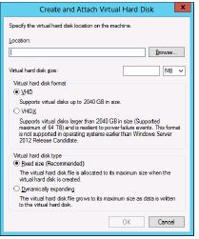
Creating and mounting virtual hard disks (Contd.,)
Fig: Configuring the Create And Attach Virtual Hard Disk settings

Slide 54
Creating and mounting virtual hard disks (Contd.,)
4. In the Location text box, type the path and file name for the file you want to create.
5. In the Virtual Hard Disk Size box, type the maximum size of the disk you want to create.
6. Select one of the following Virtual Hard Disk Format options:
VHD The original and more compatible format, which supports files of up to 2,040 GB
VHDX A new version of the format that supports files of up to 64 TB but can be read only by computers running Windows Server 2012 and Windows Server 2012 R2

Slide 55
Creating and mounting virtual hard disks (Contd.,)
7. Select one of the following Virtual Hard Disk Type options:
Fixed Size (Recommended) Allocates all the disk space for the VHD/VHDX file at once
Dynamically Expanding Allocates disk space to the VHD/VHDX file as you add data to the virtual hard disk
8. Click OK. The system creates the VHD or VHDX file and attaches it so that it appears as a disk in the snap-in.
Once you have created and attached the VHD or VHDX file, it appears as an uninitialized disk in the Disk Management snap-in and in Server Manager.
By using either tool, you can initialize the disk and create volumes on it, just as you would a physical disk.

Slide 56
Creating a storage pool
Once you have installed your physical disks, you can concatenate their space into a storage pool, from which you can create virtual disks of any size.
To create a storage pool by using Server Manager, follow this procedure.
1. In Server Manager, click the File and Storage Services icon and, in the menu that opens, click Storage Pools. The Storage Pools tile then opens, as shown in Figure.

Slide 57
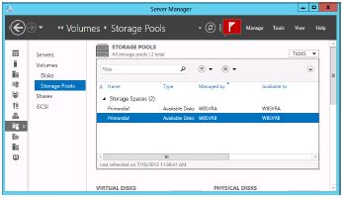
Creating a storage pool (Contd.,)
Fig: The Storage Pools tile

Slide 58
Creating a storage pool (Contd.,)
2. In the Storage Pools tile, select the primordial space on the server where you want to create the pool and, from the Tasks menu, select New Storage Pool. The New Storage Pool Wizard starts, displaying the Before You Begin page.
3. Click Next. The Specify A Storage Pool Name and Subsystem page opens, as shown in
Figure.

Slide 59
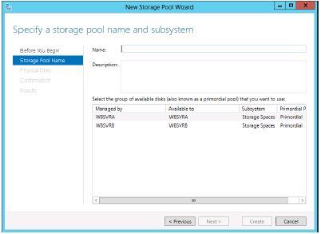
Creating a storage pool (Contd.,)
Fig: The Specify A Storage Pool Name and Subsystem page

Slide 60
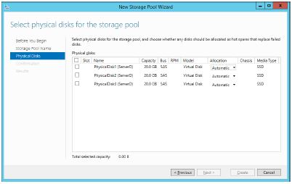
Creating a storage pool (Contd.,)
4. In the Name text box, type the name you want to assign to the storage pool.
Fig: The Select Physical Disks For The Storage Pool page

Slide 61
Creating a storage pool (Contd.,)
5. Select the check boxes for the disks you want to add to the pool and click Next to open the Confirm Selections page.
6. Click Create. The wizard creates the new storage pool and the View Results page opens.
7. Click Close. The wizard closes and the new pool appears on the Storage Pools tile, as shown in Figure.

Slide 62
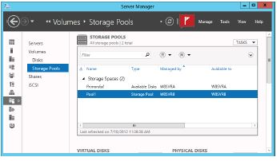
Creating a storage pool (Contd.,)
Fig: The new pool shown on the Storage Pools tile

Slide 63
Creating a storage pool (Contd.,)
8. Close the Server Manager window. After you have created a storage pool, you can modify its capacity by adding or removing physical disks. The Tasks menu in the Physical Disks tile on the Storage Pools home page contains the following options:
Add Physical Disk Enables you to add a physical disk to the pool as long as it is initialized and does not contain any volumes
Remove Disk Removes the space provided by a physical disk from the storage pool. This option is available only if all data has already been evicted from the disk.
Notes:
To create a new storage pool by using Windows PowerShell, you use the New-StoragePool
cmdlet with the following basic syntax:
New-StoragePool –FriendlyName <pool name> -StorageSubSystemFriendlyName <subsystem name>
-PhysicalDisks <CIM instances>

Slide 64
Creating virtual disks
To create a virtual disk by using Server Manager, use the following procedure.
1. In Server Manager, click the File And Storage Services icon and, in the menu that opens, click Storage Pools. The Storage Pools home page opens.
2. Select New Virtual Disk. The New Virtual Disk menu opens, displaying the Before You Begin page.
3. Click Next to open the Select The Server And Storage Pool page.
4. Select the pool in which you want to create a virtual disk and click Next. The Specify The Virtual Disk Name page opens.

Slide 65
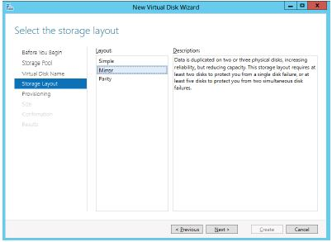
Creating virtual disks (Contd.,)
5. In the Name text box, type a name for the virtual disk and click Next. The Select The Storage Layout page opens, as shown in Figure.
Fig: The Select The Storage Layout page

Slide 66
Creating virtual disks (Contd.,)
6. Select one of the following layout options and click Next.
Simple Requires the pool to contain at least one physical disk and provides no fault tolerance. When more than one physical disk is available, the system stripes data across the disks.
Mirror Requires the pool to contain at least two physical disks and provides fault tolerance by storing identical copies of every file. Two physical disks provide protection against a single disk failure; five physical disks provide protection against two disk failures.
Parity Requires the pool to contain at least three physical disks and provides fault tolerance by striping parity information along with data.

Slide 67
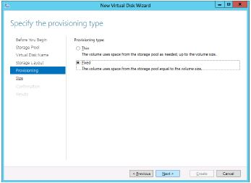
Creating virtual disks (Contd.,)
7. The Specify The Provisioning Type page opens, as shown in Figure.
Fig: The Specify The Provisioning Type page

Slide 68
Creating virtual disks (Contd.,)
8. Select one of the following Provisioning Type options and click Next.
Thin The system allocates space from the storage pool to the disk as needed, up to the maximum specified size.
Fixed The system allocates the maximum specified amount of space to the disk immediately on creating it. The Specify The Size Of The Virtual Disk page opens, as shown in Figure.

Slide 69
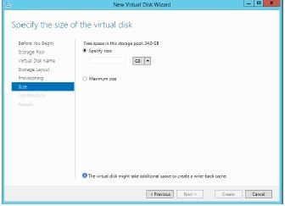
Creating virtual disks (Contd.,)
Fig: The Specify The Size Of The Virtual Disk page

Slide 70
Creating virtual disks (Contd.,)
9. In the Specify Size text box, specify the size of the disk you want to create and click Next. The Confirm Selections page opens.
10. Click Create. The View Results page opens as the wizard creates the disk.
11. Click Close. The wizard closes and the new disk opens in the Virtual Disks tile, as shown in Figure.

Slide 71
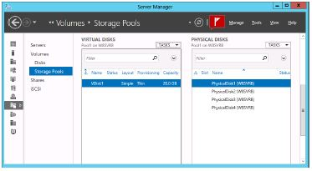
Creating virtual disks (Contd.,)
Fig: The new disk is shown in the Virtual Disks tile in Server Manager

Slide 72
Creating virtual disks (Contd.,)
12. Close the Server Manager window.
By default, the New Volume Wizard launches when you create a new virtual disk.
At this point, the disk is a virtual equivalent of a newly installed physical disk.
It contains nothing but unallocated space, and you must create at least one volume before you can store data on it.

Slide 73
Creating a simple volume
To create a new simple volume on a basic or dynamic disk by using the Disk Management snap-in, use the following procedure.
1. In Server Manager, click Tools and click Computer Management. The Computer Management console opens.
2. Click Disk Management to launch the Disk Management snap-in.
3. In the Graphical View, right-click an unallocated area in the disk on which you want to create a volume and, from the shortcut menu, select New Simple Volume. The New Simple Volume Wizard starts.
4. Click Next to bypass the Welcome page. The Specify Volume Size page opens, as shown in Figure.

Slide 74
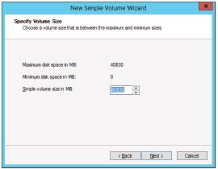
Creating a simple volume (Contd.,)
Fig: Configuring the Specify Volume Size page

Slide 75
Creating a simple volume (Contd.,)
5. Select the size for the new partition or volume, within the maximum and minimum limits stated on the page, by using the Simple Volume Size In MB spin box, and then click Next.
The Assign Drive Letter Or Path page opens, as shown in Figure.

Slide 76
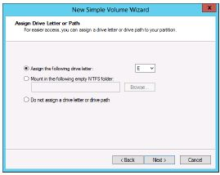
Creating a simple volume (Contd.,)
Fig: Configuring the Assign Drive Letter Or Path page

Slide 77
Creating a simple volume (Contd.,)
6. Configure one of the following three options:
Assign The Following Drive Letter If you select this option, click the associated drop-down list for a list of available drive letters and select the letter you want to assign to the drive.
Mount In The Following Empty NTFS Folder If you select this option, either type the path to an existing NTFS folder or click Browse to search for or create a new folder. The entire contents of the new drive will appear in the folder you specify.
Do Not Assign A Drive Letter Or Drive Path Select this option if you want to create the partition but are not yet ready to use it. When you do not assign a volume a drive letter or path, the drive is left unmounted and inaccessible. When you want to mount the drive for use, assign a drive letter or path to it.
7. Click Next to open the Format Partition page, as shown in Figure.

Slide 78
Creating a simple volume (Contd.,)
8. Specify whether the wizard should format the volume and if so, how. If you do not want to format the volume at this time, select the Do Not Format This Volume option.
If you want to format the volume, select the Format This Volume With The Following Settings option, and then configure the associated options as follows.
File System Select the desired file system. The options available depend on the size of the volume and can include ReFS, NTFS, exFAT, FAT32, and FAT.
Allocation Unit Size Specify the file system’s cluster size. The cluster size signifies the basic unit of bytes in which the system allocates disk space.

Slide 79
Creating a simple volume (Contd.,)
Volume Label Specify a name for the partition or volume. The default name is New Volume, but you can change the name to anything you want.
Perform A Quick Format When this check box is selected, Windows formats the disk without checking for errors. This is a faster method to format the drive, but Microsoft does not recommend it. When you check for errors, the system looks for and marks bad sectors on the disk so that your clients will not use those portions of the disk.
Enable File And Folder Compression Selecting this check box turns on folder compression for the disk.

Slide 80
Creating a simple volume (Contd.,)
9. Click Next. The Completing The New Simple Volume Wizard page opens.
10. Review the settings to confirm your options and then click Finish. The wizard creates the volume according to your specifications.
11. Close the console containing the Disk Management snap-in.

Slide 81
Creating a striped, spanned, mirrored, or RAID-5 volume
To create a striped, spanned, mirrored, or RAID-5 volume, use the following procedure.
1. In Server Manager, click Tools and click Computer Management. The Computer Management console opens.
2. Click Disk Management to open the Disk Management snap-in.
3. Right-click an unallocated area on a disk and then, from the shortcut menu, select the command for the type of volume you want to create. A New Volume Wizard starts, named for your selected volume type.
4. Click Next to bypass the Welcome page. The Select Disks page opens, as shown in Figure.

Slide 82
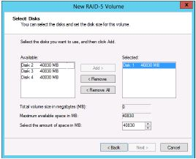
Creating a striped, spanned, mirrored, or RAID-5 volume (Contd.,)
Fig: Configuring the Select Disks page

Slide 83
Creating a striped, spanned, mirrored, or RAID-5 volume (Contd.,)
5. On the Select Disks page, select the disks you want to use for the new volume from the Available list box and then click Add.
6. Specify the amount of space you want to use on each disk by using the Select the Amount of Space in MB spin box. Then click Next.
7. Specify whether you want to assign a drive letter or path and then click Next. The Format Partition page opens.

Slide 84
Creating a striped, spanned, mirrored, or RAID-5 volume (Contd.,)
8. Specify if or how you want to format the volume and then click Next. The Completing The New Simple Volume Wizard page opens.
9. Review the settings to confirm your options and then click Finish.
10. Click Yes. The wizard creates the volume according to your specifications.
11. Close the Disk Management snap-in.

Slide 85
Summary
Windows Server 2012 R2 supports two hard disk partition types: MBR and GPT; two disk types: basic and dynamic; five volume types: simple, striped, spanned, mirrored, and RAID-5; and three file systems: ReFS, NTFS, and FAT.
The Disk Management snap-in can initialize, partition, and format disks on the local machine. Server Manager can perform many of the same tasks for servers all over the network.

Slide 86
Summary (Contd.,)
Windows Server 2012 R2 includes a new disk virtualization technology called Storage Spaces, which enables a server to concatenate storage space from individual physical disks and allocate that space to create virtual disks of any size supported by the hardware.
All Windows Server 2012 R2 installations include the File and Storage Services role, which causes Server Manager to display a menu when you click the icon in the navigation pane. This menu provides access to home pages that enable administrators to manage volumes, disks, storage pools, shares, and iSCSI devices.

Slide 87
Summary (Contd.,)
The Disk Management snap-in in Windows Server 2012 R2 enables you to create VHD files and mount them on the computer.
Once you have installed your physical disks, you can concatenate their space into a storage pool, from which you can create virtual disks of any size. Once you have created a storage pool, you can use the space to create as many virtual disks as you need.

Slide 88
Thank you

